Slide 1
BIEN 401 Biomedical Mass Transport Class 14 Pharmacokinetic Analysis
notes prepared by
Dr. Louis Reis
Created on 4/9/2022

Slide 2
Pharmacokinetics
Pharmacokinetics (PK)- study of the processes that affect drug distribution and the rate of change of drug concentrations within various regions of the body.
A
D
M
E
T
Pharmaceutics – formulation and preparation of drug to achieve a desired drug availability
Pharmacodynamics – study of time course of the treatment response
Pharmacology – study of the physiological response to the drug

Slide 3
Drug Entry Routes
Two routes for drug delivery:
_________ – GI tract
Buccal cavity (mouth)
Sublingually (beneath the tongue)
Gastrically (stomach)
Intestinally (small and large intestines)
Rectally
___________ – all other routes – mostly enter the systemic circulation directly
Drugs absorbed through the buccal cavity or lower rectum enter systemic circulation directly.
Drugs absorbed elsewhere in GI tract enter ___________ circulation first where they are metabolized by the liver first (will remove a significant part of the drug), then will enter systemic circulation.

Slide 4
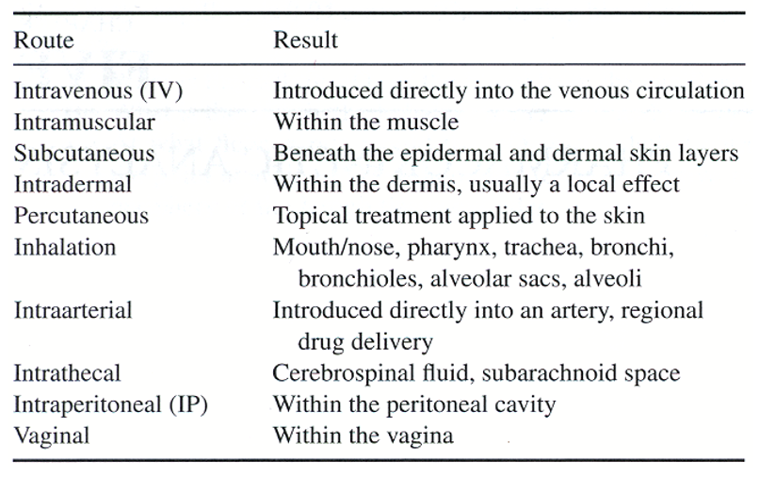
Drug Entry Routes
Parenteral (most drugs enter systemic circulation directly)

Slide 5
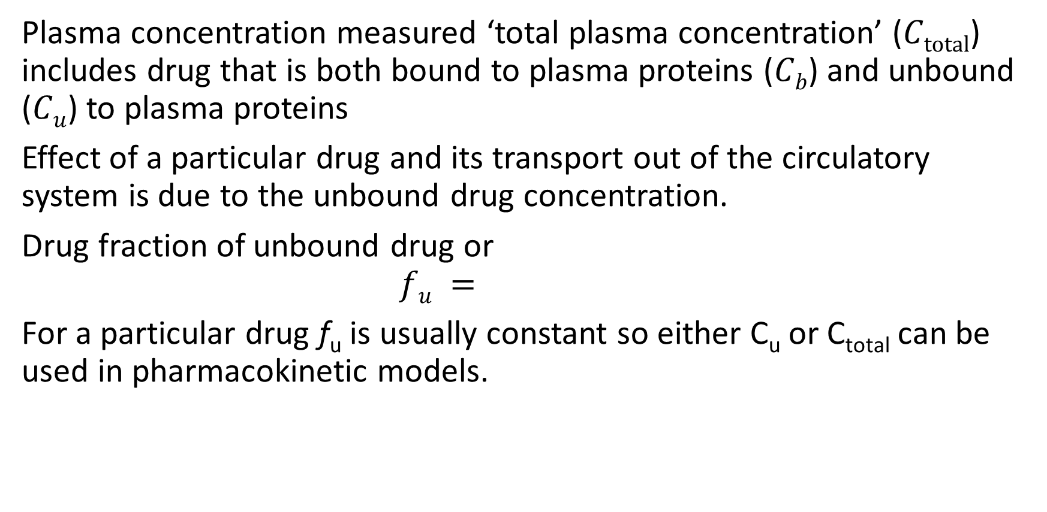
Plasma Concentration
Plasma concentration measured ‘total plasma concentration’ ($Ctotal$) includes drug that is both bound to plasma proteins ($Cb$) and unbound ($Cu$) to plasma proteins
Effect of a particular drug and its transport out of the circulatory system is due to the unbound drug concentration.
Drug fraction of unbound drug or
$$fu =$$
For a particular drug f_{u} is usually constant so either C_{u} or C_{total} can be used in pharmacokinetic models.

Slide 6
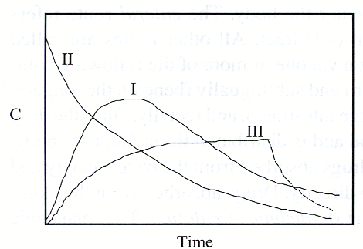
Time Course of Plasma Drug Concentration
Drug concentrations may vary with time depending on how they are introduced:
I – Drug is ___________ slowly, plateaus, and then decrease as drug is eliminated from body.
II – Drug is introduced quickly by _____ _________(IV) injection (bolus injection)
III – Drug is continuous introduced intravenously (__________________). Reaches steady state where infusion and elimination rates are equal. When it stops, drug concentration decays to 0.

Slide 7
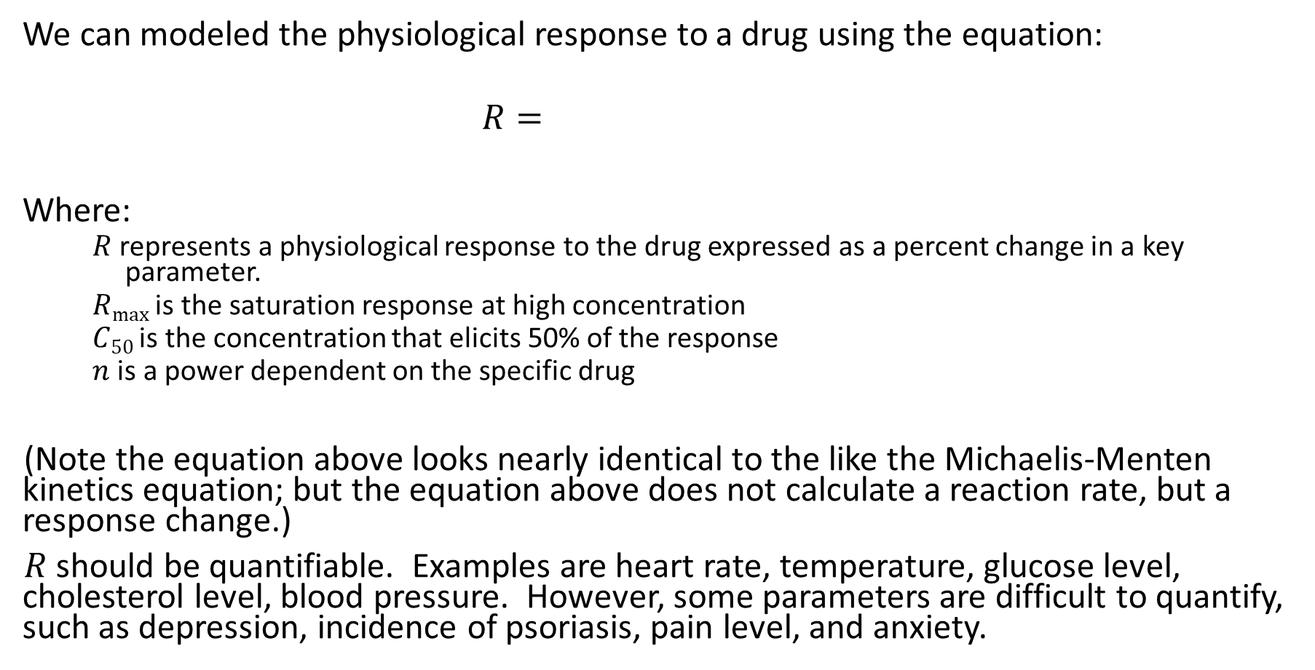
Physiological Response
We can modeled the physiological response to a drug using the equation:
$$R=$$
Where:
$R$ represents a physiological response to the drug expressed as a percent change in a key parameter.
$Rmax$ is the saturation response at high concentration
$C50$ is the concentration that elicits 50% of the response
$n$ is a power dependent on the specific drug
(Note the equation above looks nearly identical to the like the Michaelis-Menten kinetics equation; but the equation above does not calculate a reaction rate, but a response change.)
$R$ should be quantifiable. Examples are heart rate, temperature, glucose level, cholesterol level, blood pressure. However, some parameters are difficult to quantify, such as depression, incidence of psoriasis, pain level, and anxiety.

Slide 8
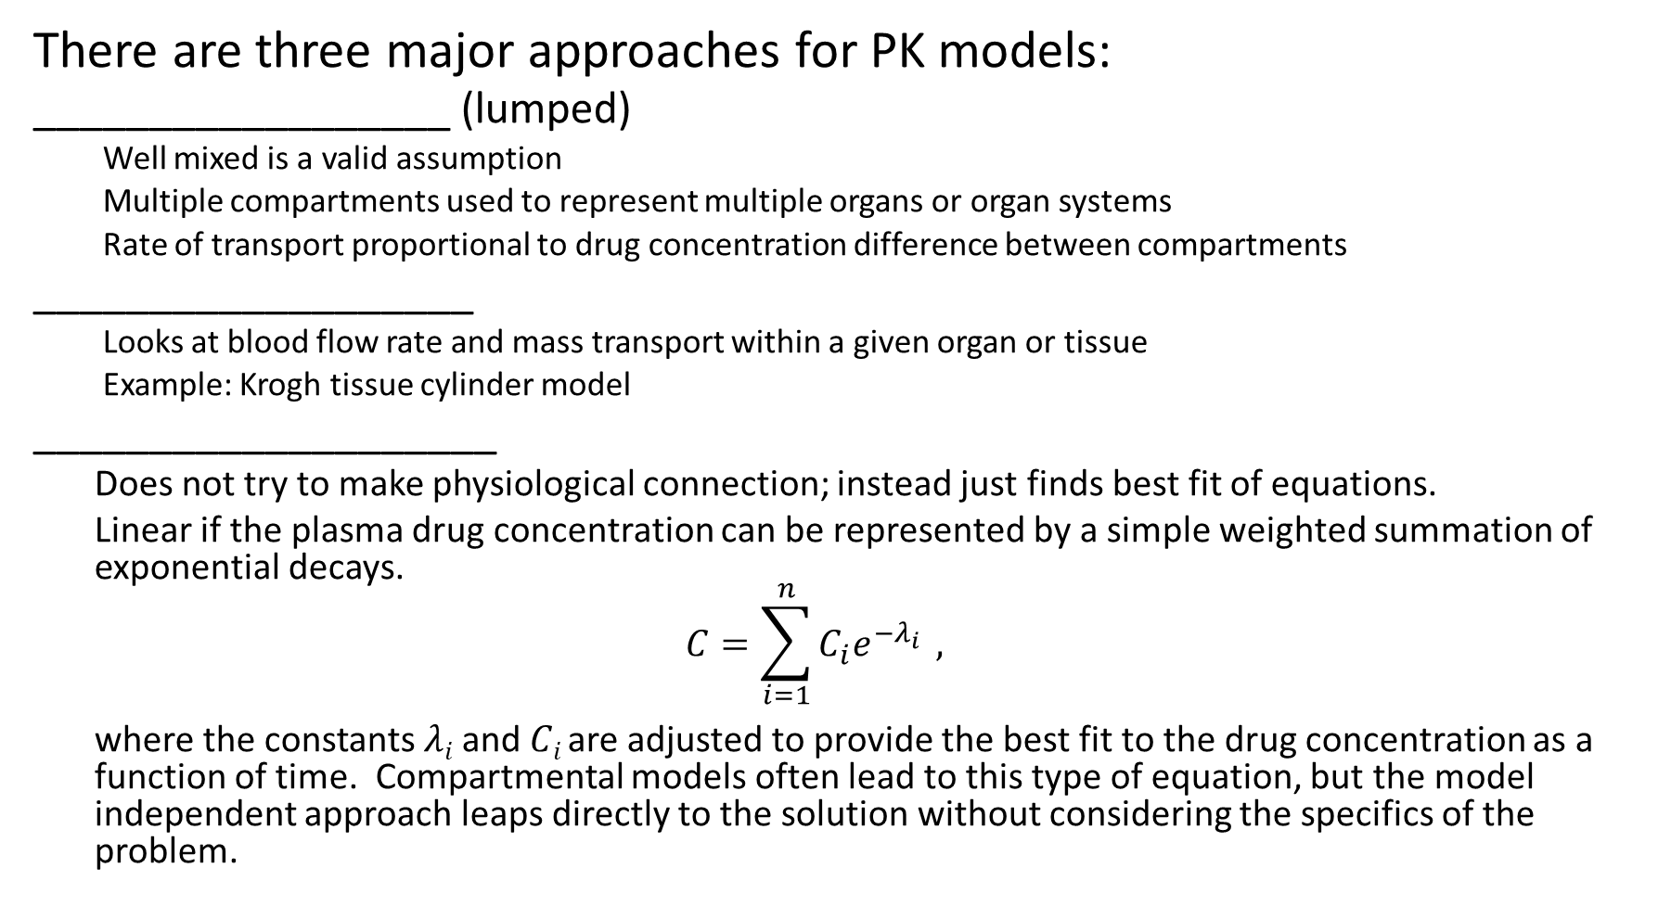
Modeling Approaches
There are three major approaches for PK models:
__________________ (lumped)
Well mixed is a valid assumption
Multiple compartments used to represent multiple organs or organ systems
Rate of transport proportional to drug concentration difference between compartments
___________________
Looks at blood flow rate and mass transport within a given organ or tissue
Example: Krogh tissue cylinder model
____________________
Does not try to make physiological connection; instead just finds best fit of equations.
Linear if the plasma drug concentration can be represented by a simple weighted summation of exponential decays.
$$C=\sum_{i=1}^{n}{C_{i}e^{−λ_{i}}} ,$$
where the constants $λi$ and $Ci$ are adjusted to provide the best fit to the drug concentration as a function of time. Compartmental models often lead to this type of equation, but the model independent approach leaps directly to the solution without considering the specifics of the problem.

Slide 9
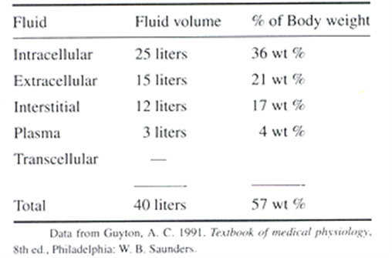
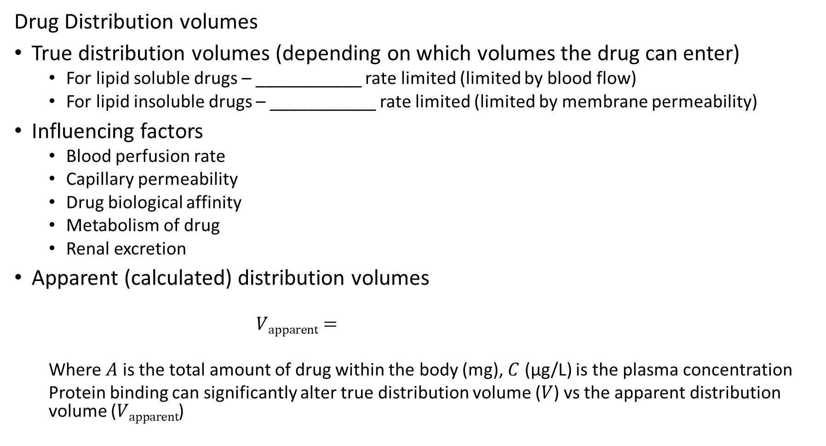
Drug Distribution
Drug Distribution volumes
True distribution volumes (depending on which volumes the drug can enter)
For lipid soluble drugs – ___________ rate limited (limited by blood flow)
For lipid insoluble drugs – ___________ rate limited (limited by membrane permeability)
Influencing factors
Blood perfusion rate
Capillary permeability
Drug biological affinity
Metabolism of drug
Renal excretion
Apparent (calculated) distribution volumes
$$Vapparent=$$
Where $A$ is the total amount of drug within the body (mg), $C$ (μg/L) is the plasma concentration
Protein binding can significantly alter true distribution volume ($V$) vs the apparent distribution volume ($Vapparent$)

Slide 10
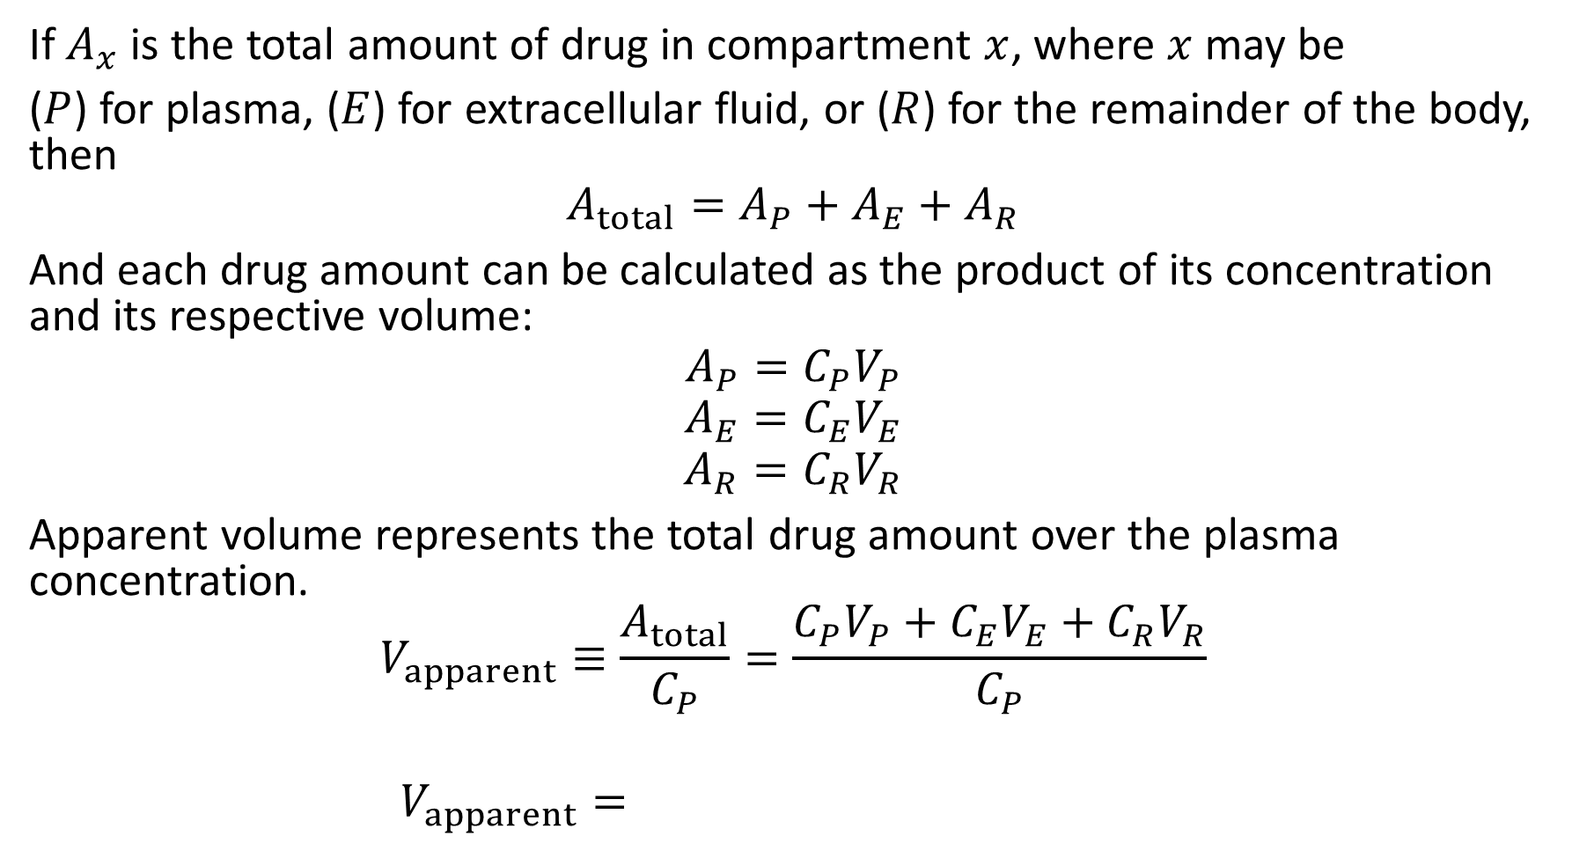
Apparent Distribution Volume and Protein Binding
If $A_{x}$ is the total amount of drug in compartment $x$, where $x$ may be
($P$) for plasma, ($E$) for extracellular fluid, or ($R$) for the remainder of the body, then
$$A_{total}=A_{P}+A_{E}+A_{R}$$
And each drug amount can be calculated as the product of its concentration and its respective volume:
$$A_{P}=C_{P}V_{P}$$
$$A_{E}=C_{E}V_{E}$$
$$A_{R}=C_{R}V_{R}$$
Apparent volume represents the total drug amount over the plasma concentration.
$$V_{apparent}≡\frac{A_{total}}{C_{P}}=\frac{C_{P}V_{P}+C_{E}V_{E}+C_{R}V_{R}}{C_{P}}$$
$$V_{apparent}=$$

Slide 11
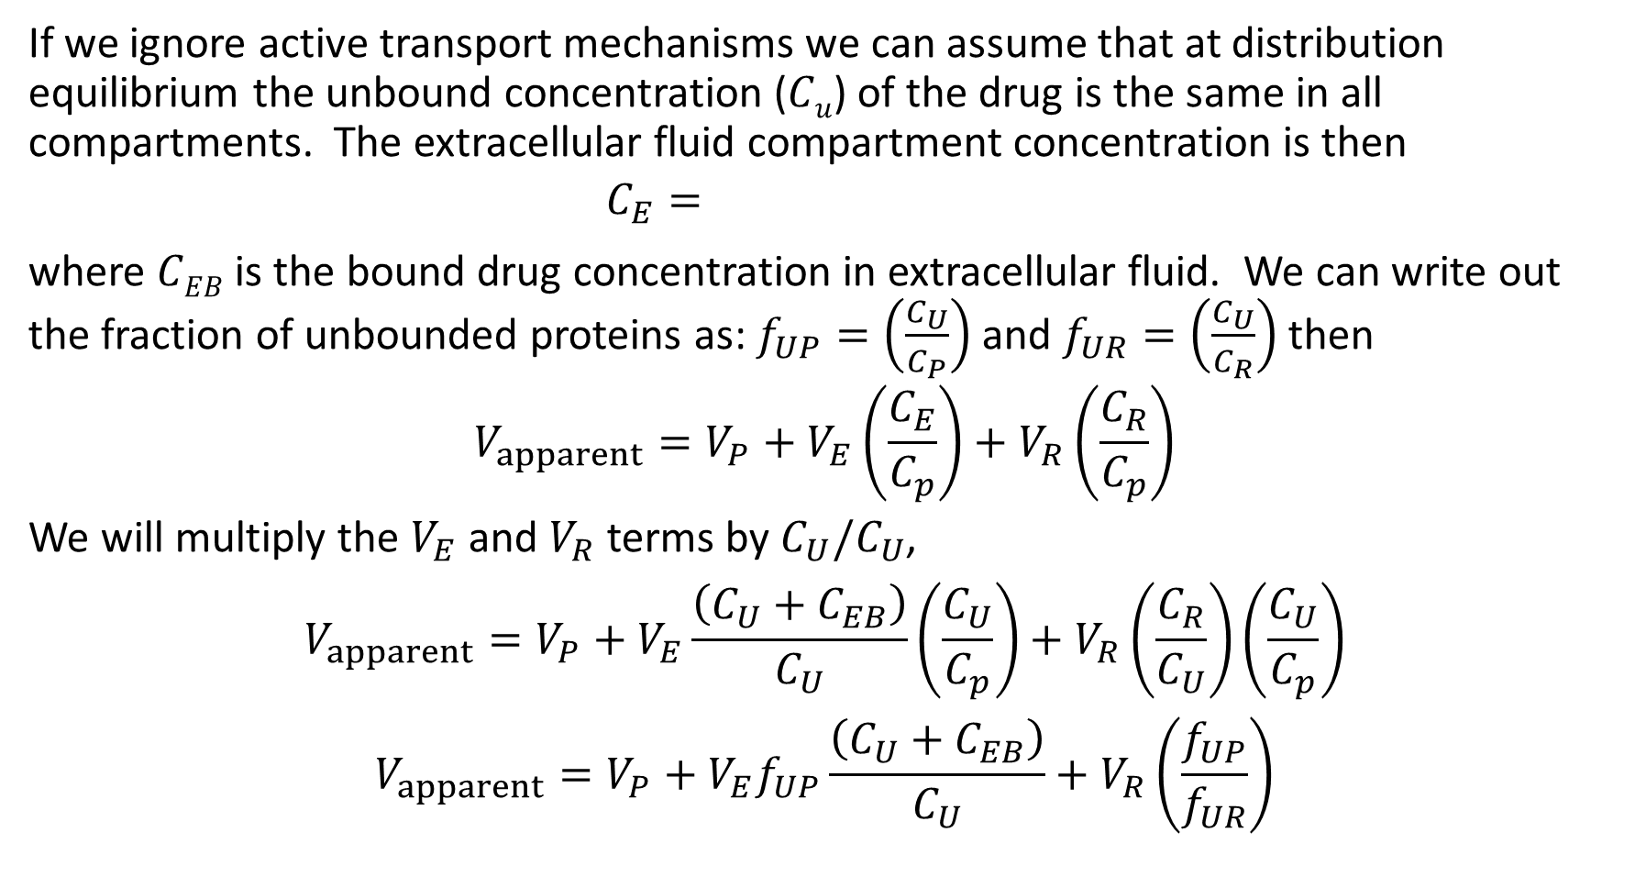
Apparent Distribution Volume and Protein Binding
If we ignore active transport mechanisms we can assume that at distribution equilibrium the unbound concentration ($Cu$) of the drug is the same in all compartments. The extracellular fluid compartment concentration is then
$$C_{E}=$$
where $CEB$ is the bound drug concentration in extracellular fluid. We can write out the fraction of unbounded proteins as: $f_{UP}=\left(\frac{C_{U}}{C_{P}}\right)$ and $f_{UR}=\left(\frac{C_{U}}{C_{R}}\right)$ then
$$V_{apparent}=V_{P}+V_{E}\left(\frac{C_{E}}{C_{p}}\right)+V_{R}\left(\frac{C_{R}}{C_{p}}\right)$$
We will multiply the $V_{E}$ and $V_{R}$ terms by $C_{U}/C_{U}$,
$$V_{apparent}=V_{P}+V_{E}\frac{\left(C_{U}+C_{EB}\right)}{C_{U}}\left(\frac{C_{U}}{C_{p}}\right)+V_{R}\left(\frac{C_{R}}{C_{U}}\right)\left(\frac{C_{U}}{C_{p}}\right)$$
$$V_{apparent}=V_{P}+V_{E}f_{UP}\frac{\left(C_{U}+C_{EB}\right)}{C_{U}}+V_{R}\left(\frac{f_{UP}}{f_{UR}}\right)$$

Slide 12
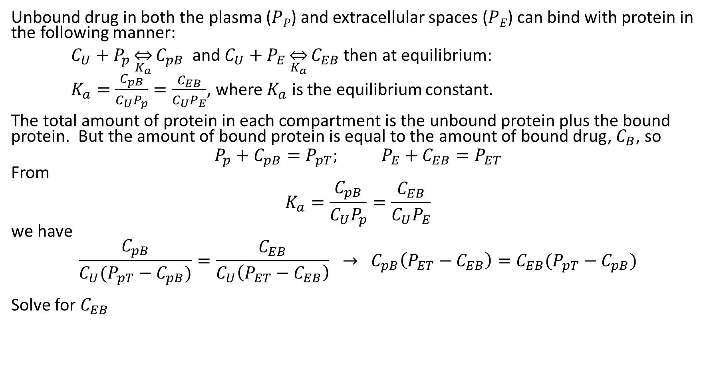
Protein Binding
Unbound drug in both the plasma ($PP$) and extracellular spaces ($PE$) can bind with protein in the following manner:
$C_{U}+P_{p}\overset{⇔}{K_{a}}C_{pB}$ and $C_{U}+P_{E}\overset{⇔}{K_{a}}C_{EB}$ then at equilibrium:
$K_{a}=\frac{C_{pB}}{C_{U}P_{p}}=\frac{C_{EB}}{C_{U}P_{E}}$, where $K_{a}$ is the equilibrium constant.
The total amount of protein in each compartment is the unbound protein plus the bound protein. But the amount of bound protein is equal to the amount of bound drug, $C_{B}$, so
$$P_{p}+C_{pB}=P_{pT}; P_{E}+C_{EB}=P_{ET}$$
From
$$K_{a}=\frac{C_{pB}}{C_{U}P_{p}}=\frac{C_{EB}}{C_{U}P_{E}}$$
we have
$$\frac{C_{pB}}{C_{U}(P_{pT}−C_{pB})}=\frac{C_{EB}}{C_{U}\left(P_{ET}−C_{EB}\right)} → C_{pB}\left(P_{ET}−C_{EB}\right)=C_{EB}(P_{pT}−C_{pB})$$
Solve for $C_{EB}$

Slide 13
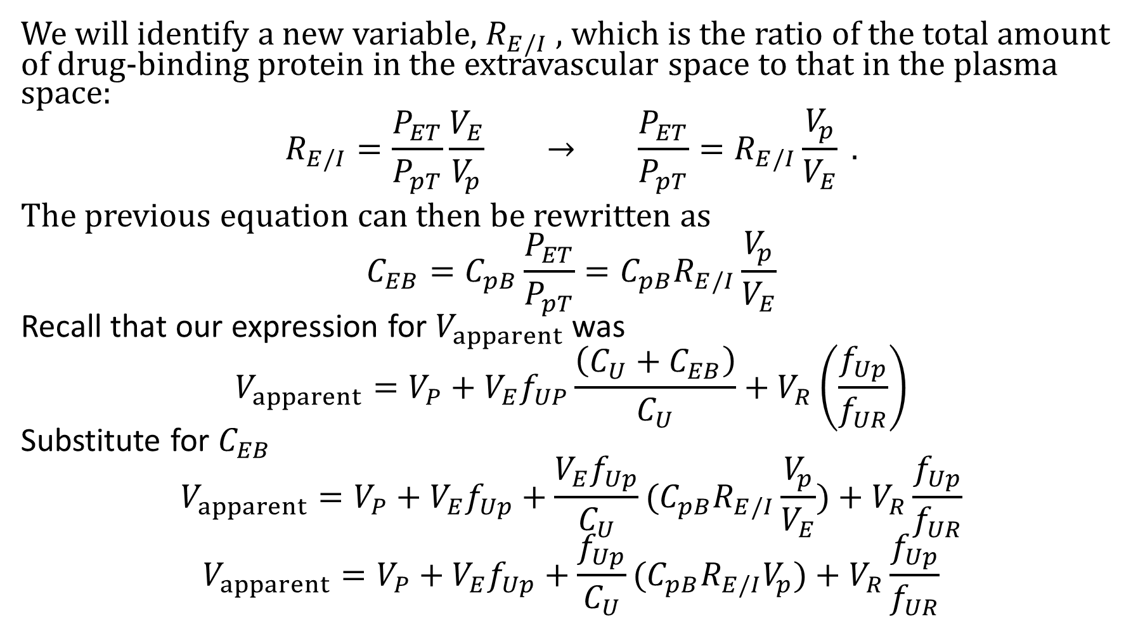
Protein Binding
We will identify a new variable, $R_{E/I}$ , which is the ratio of the total amount of drug-binding protein in the extravascular space to that in the plasma space:
$$R_{E/I}=\frac{P_{ET}}{P_{pT}}\frac{V_{E}}{V_{p}} → \frac{P_{ET}}{P_{pT}}=R_{E/I}\frac{V_{p}}{V_{E}} .$$
The previous equation can then be rewritten as
$$C_{EB}=C_{pB}\frac{P_{ET}}{P_{pT}}=C_{pB}R_{E/I}\frac{V_{p}}{V_{E}}$$
Recall that our expression for $V_{apparent}$ was
$$V_{apparent}=V_{P}+V_{E}f_{UP}\frac{\left(C_{U}+C_{EB}\right)}{C_{U}}+V_{R}\left(\frac{f_{Up}}{f_{UR}}\right)$$
Substitute for $C_{EB}$
$$V_{apparent}=V_{P}+V_{E}f_{Up}+\frac{V_{E}f_{Up}}{C_{U}}(C_{pB}R_{E/I}\frac{V_{p}}{V_{E}})+V_{R}\frac{f_{Up}}{f_{UR}}$$
$$V_{apparent}=V_{P}+V_{E}f_{Up}+\frac{f_{Up}}{C_{U}}(C_{pB}R_{E/I}V_{p})+V_{R}\frac{f_{Up}}{f_{UR}}$$

Slide 14
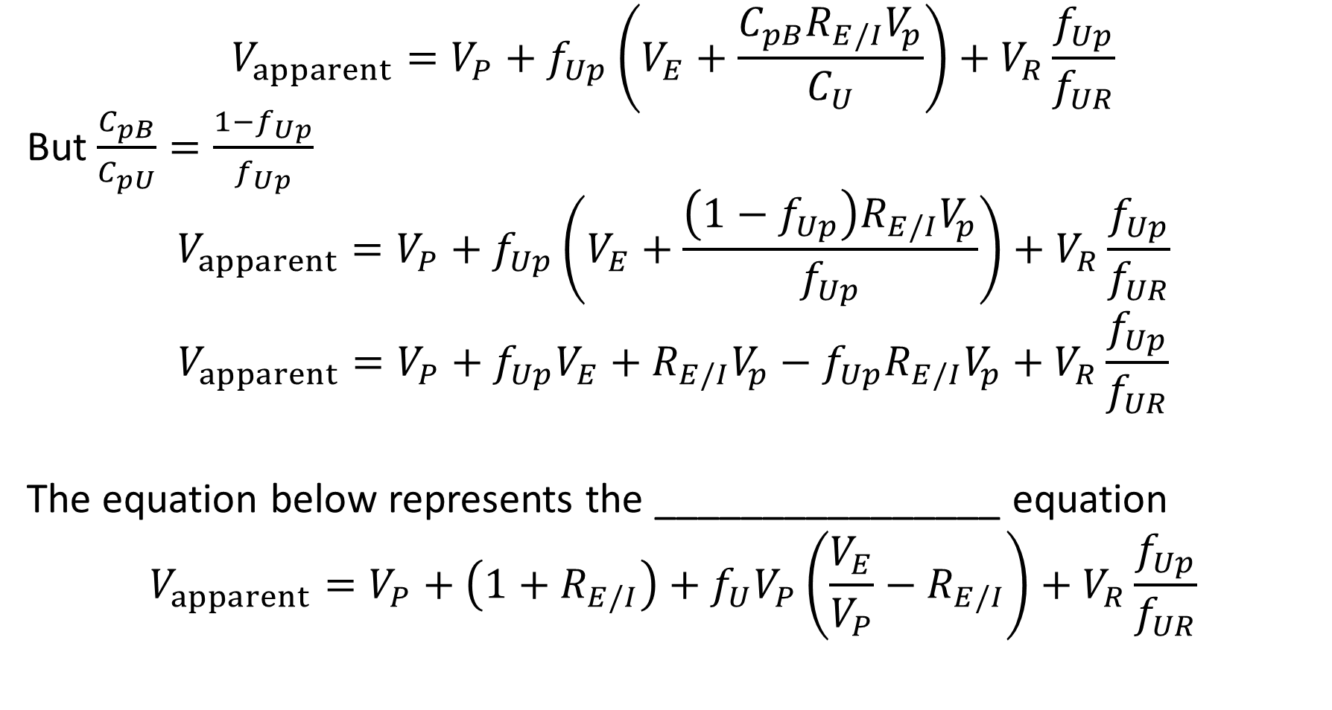
Protein Binding
$$V_{apparent}=V_{P}+f_{Up}\left(V_{E}+\frac{C_{pB}R_{E/I}V_{p}}{C_{U}}\right)+V_{R}\frac{f_{Up}}{f_{UR}}$$
But $\frac{C_{pB}}{C_{pU}}=\frac{1−f_{Up}}{f_{Up}}$
$$V_{apparent}=V_{P}+f_{Up}\left(V_{E}+\frac{\left(1−f_{Up}\right)R_{E/I}V_{p}}{f_{Up}}\right)+V_{R}\frac{f_{Up}}{f_{UR}}$$
$$V_{apparent}=V_{P}+f_{Up}V_{E}+R_{E/I}V_{p}−f_{Up}R_{E/I}V_{p}+V_{R}\frac{f_{Up}}{f_{UR}}$$
The equation below represents the ________________ equation
$$V_{apparent}=V_{P}+\left(1+R_{E/I}\right)+f_{U}V_{P}\left(\frac{V_{E}}{V_{P}}−R_{E/I}\right)+V_{R}\frac{f_{Up}}{f_{UR}}$$

Slide 15
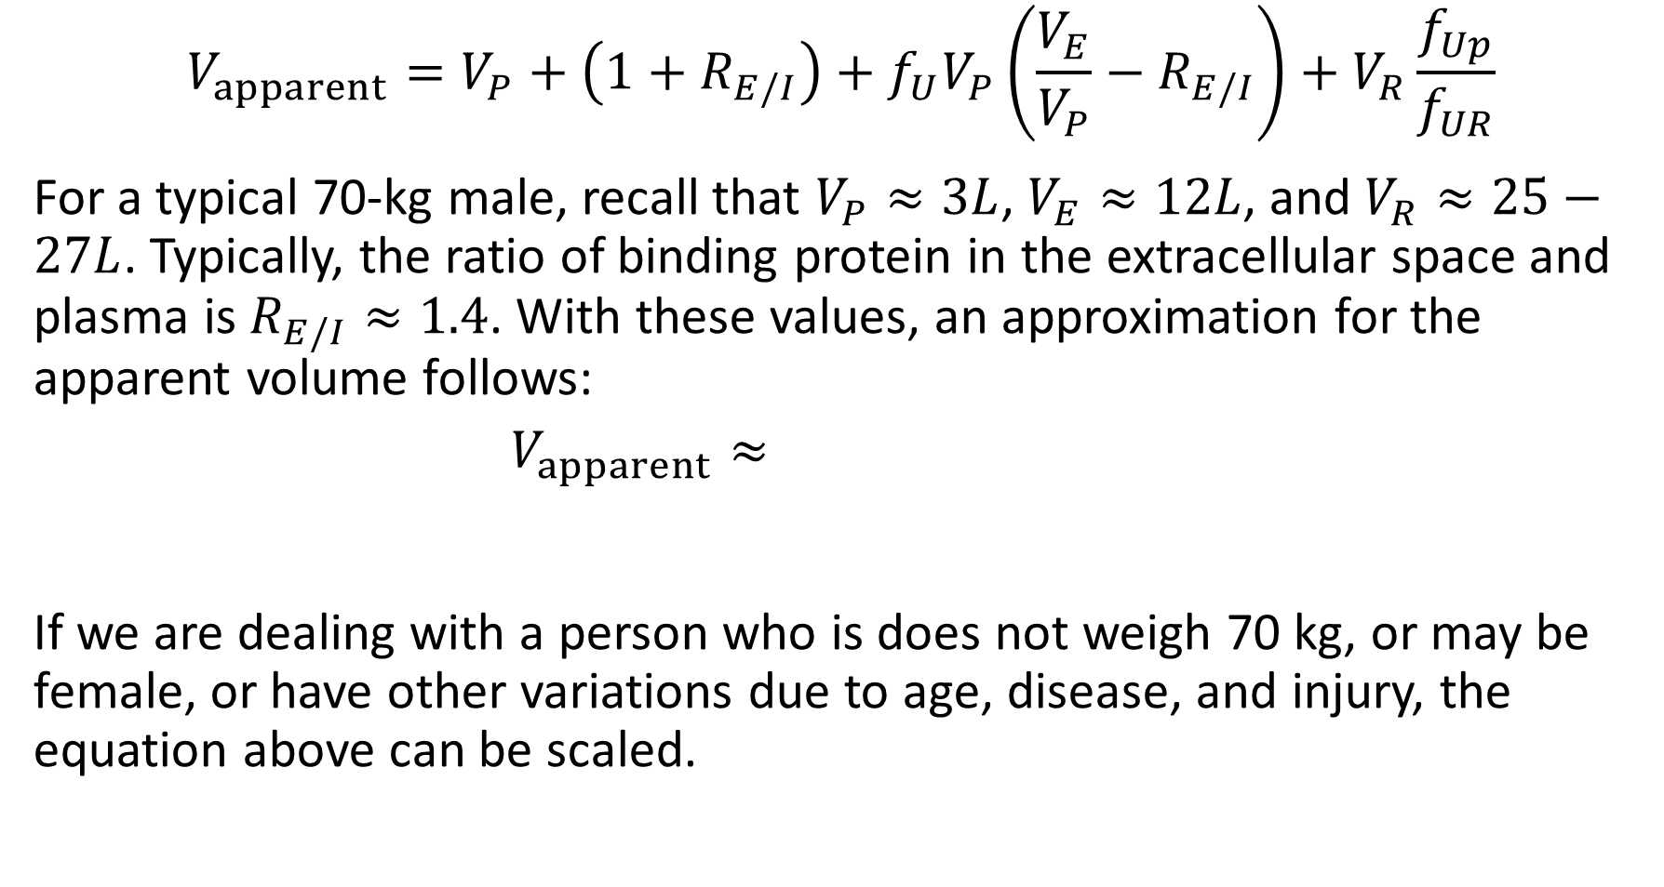
Oie-Tozer Equation
$$V_{apparent}=V_{P}+\left(1+R_{E/I}\right)+f_{U}V_{P}\left(\frac{V_{E}}{V_{P}}−R_{E/I}\right)+V_{R}\frac{f_{Up}}{f_{UR}}$$
For a typical 70-kg male, recall that $V_{P}≈3L$, $V_{E}≈12L$, and $V_{R}≈25−27L$. Typically, the ratio of binding protein in the extracellular space and plasma is $R_{E/I}≈1.4$. With these values, an approximation for the apparent volume follows:
$$V_{apparent}≈$$
If we are dealing with a person who is does not weigh 70 kg, or may be female, or have other variations due to age, disease, and injury, the equation above can be scaled.

Slide 16
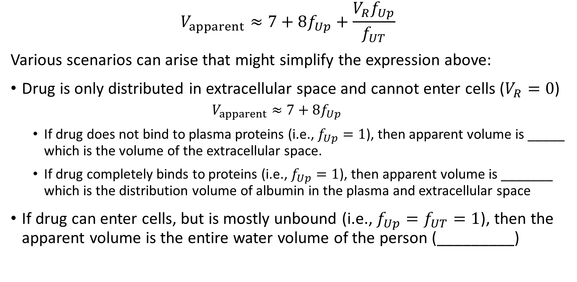
Oie-Tozer Equation
$$V_{apparent}≈7+8f_{Up}+\frac{V_{R}f_{Up}}{f_{UT}}$$
Various scenarios can arise that might simplify the expression above:
Drug is only distributed in extracellular space and cannot enter cells ($V_{R}=0$)
$$V_{apparent}≈7+8f_{Up}$$
If drug does not bind to plasma proteins (i.e., $f_{Up}=1$), then apparent volume is _____ which is the volume of the extracellular space.
If drug completely binds to proteins (i.e., $f_{Up}=1$), then apparent volume is _______ which is the distribution volume of albumin in the plasma and extracellular space
If drug can enter cells, but is mostly unbound (i.e., $f_{Up}=f_{UT}=1$), then the apparent volume is the entire water volume of the person (_________)

Slide 17
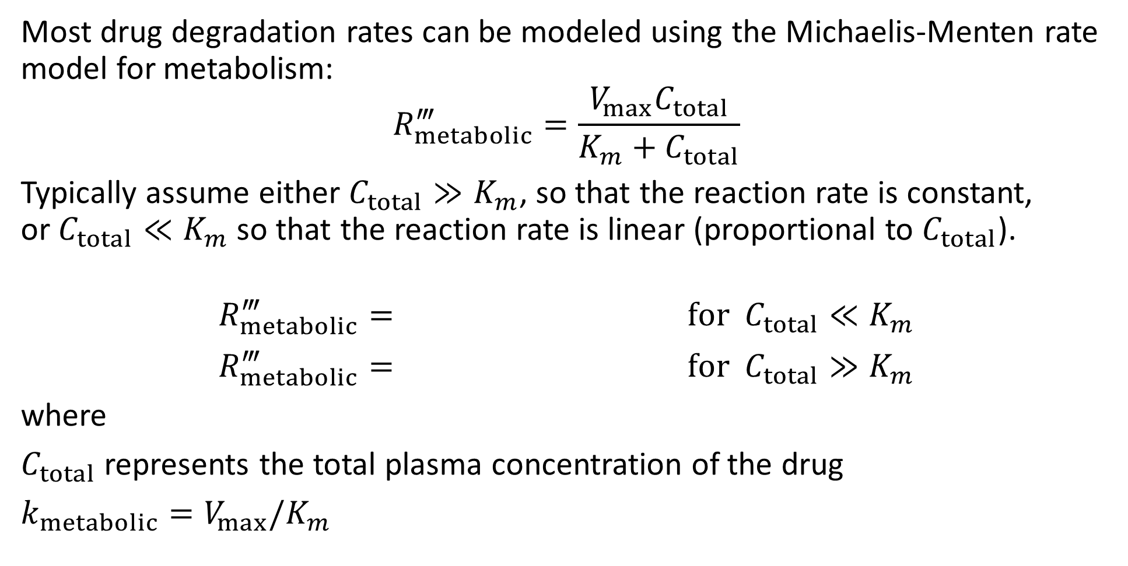
Drug Degradation
Most drug degradation rates can be modeled using the Michaelis-Menten rate model for metabolism:
$$R_{metabolic}^{‴}=\frac{V_{max}C_{total}}{K_{m}+C_{total}}$$
Typically assume either $C_{total}≫K_{m}$, so that the reaction rate is constant, or$C_{total}≪K_{m}$ so that the reaction rate is linear (proportional to $C_{total}$).
$$R_{metabolic}^{‴}= \text{for} C_{total}≪K_{m}$$
$$R_{metabolic}^{‴}= \text{for} C_{total}≫K_{m}$$
where
$C_{total}$ represents the total plasma concentration of the drug
$k_{metabolic}=V_{max}/K_{m}$

Slide 18
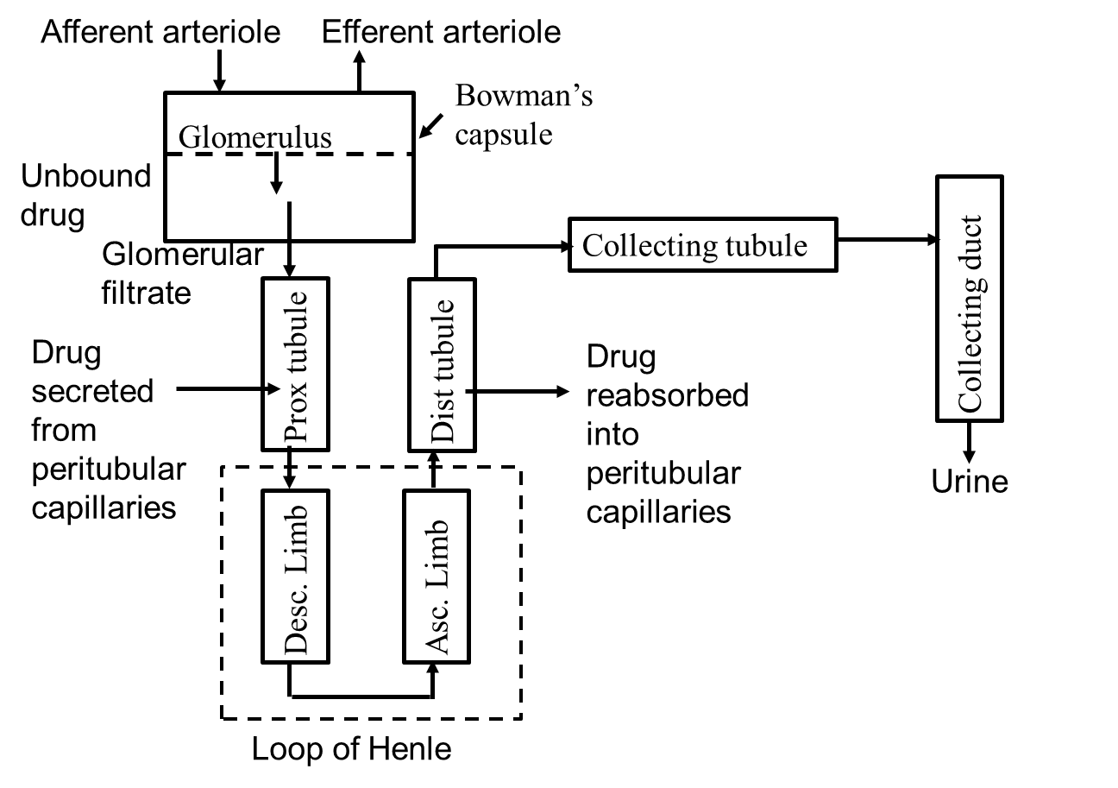
Renal Excretion of a Drug
Kidneys receive about 1100 mL/min of blood (22% of cardiac output)
Form concentrated urine at about 1.5L per day
Blood enters glomerulus which has capillaries with high permeabilities; has very high hydrodynamic and osmotic pressure differences
Glomerulus capillary is impermeable to plasma proteins larger than 69 kDa.
Unbounded drug smaller than 69 kDa is readily filtered out of bloodstream

Slide 19
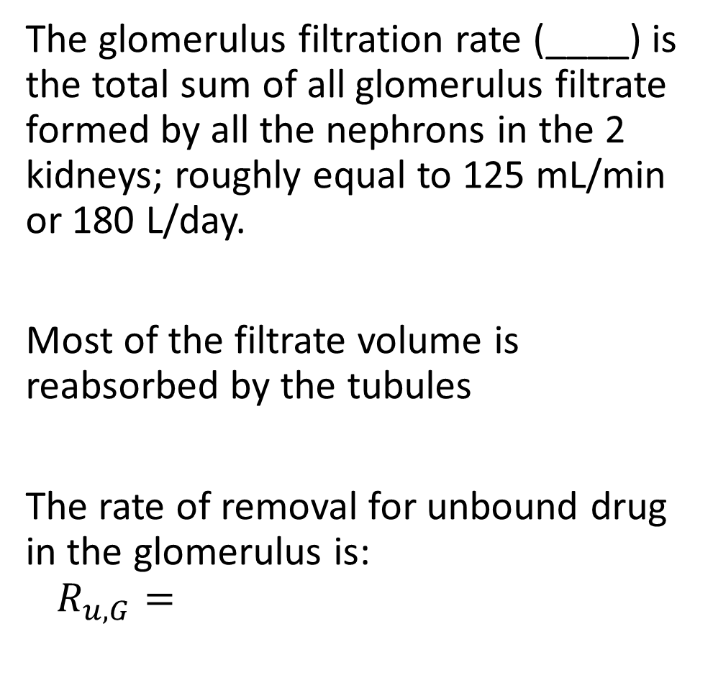
Renal Excretion of a Drug
The glomerulus filtration rate (____) is the total sum of all glomerulus filtrate formed by all the nephrons in the 2 kidneys; roughly equal to 125 mL/min or 180 L/day.
Most of the filtrate volume is reabsorbed by the tubules
The rate of removal for unbound drug in the glomerulus is:
$$R_{u,G}=$$

Slide 20
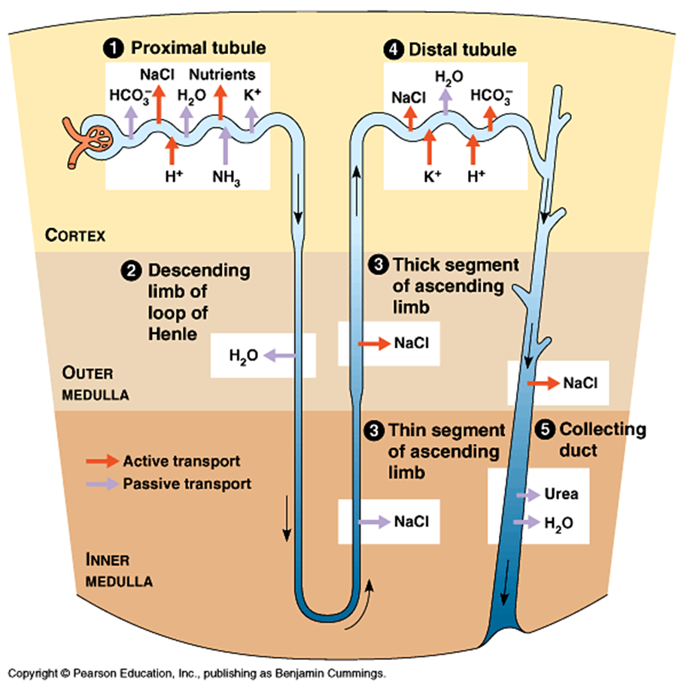
Renal Excretion of a Drug
In the proximal tubule, water, salt, along with glucose and amino acids are reabsorbed back into the blood.
Active transport can quickly remove drugs from the blood stream here.
Drugs can be reabsorbed by the _____ tubule.
In summary, drug elimination by the kidney is affected by filtration through the _________________, secretion into the proximal tubules, and reabsorption within the distal tubules.

Slide 21
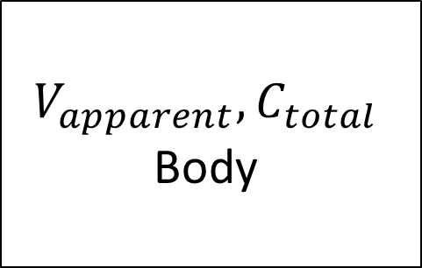
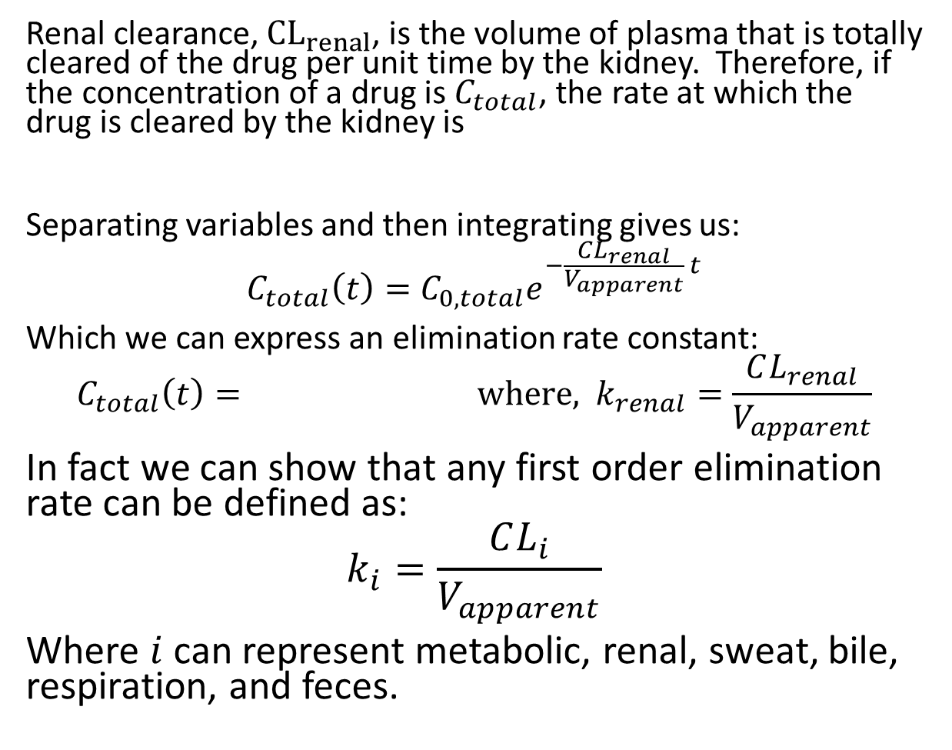


Renal Clearance and Compartment Model
Renal clearance, ${\text{CL}}_{renal}$, is the volume of plasma that is totally cleared of the drug per unit time by the kidney. Therefore, if the concentration of a drug is $C_{total}$, the rate at which the drug is cleared by the kidney is
Separating variables and then integrating gives us:
$$C_{total}\left(t\right)=C_{0,total}e^{−\frac{CL_{renal}}{V_{apparent}} t}$$
Which we can express an elimination rate constant:
$$C_{total}\left(t\right)= \text{where}\text{,} k_{renal}=\frac{CL_{renal}}{V_{apparent}}$$
In fact we can show that any first order elimination rate can be defined as:
$$k_{i}=\frac{CL_{i}}{V_{apparent}}$$
Where $i$ can represent metabolic, renal, sweat, bile, respiration, and feces.
$$V_{apparent}, C_{total}$$
Body
$$C_{total}=0$$
$$CL_{renal}C_{total}$$
Kidney

Slide 22
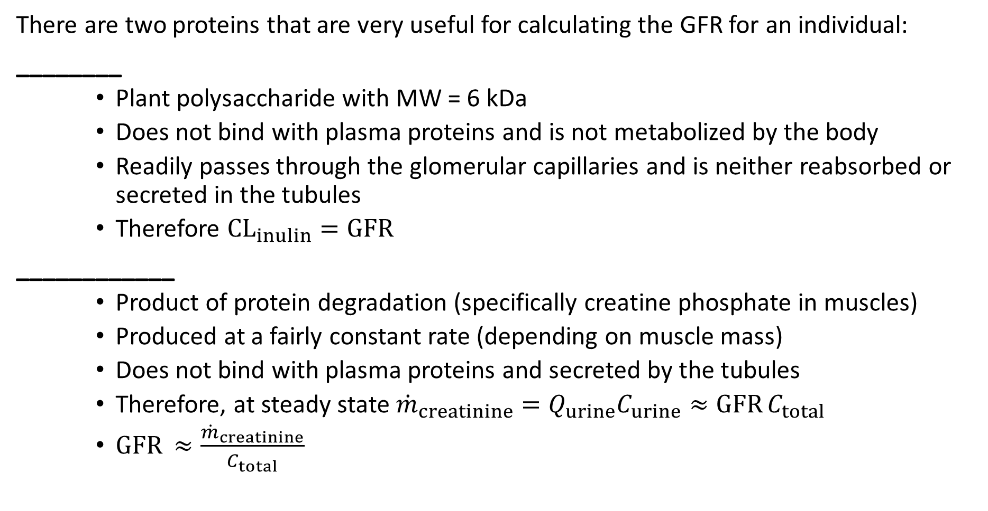
Renal Clearance and Estimating GFR
There are two proteins that are very useful for calculating the GFR for an individual:
________
Plant polysaccharide with MW = 6 kDa
Does not bind with plasma proteins and is not metabolized by the body
Readily passes through the glomerular capillaries and is neither reabsorbed or secreted in the tubules
Therefore $CL_{inulin}=GFR$
____________
Product of protein degradation (specifically creatine phosphate in muscles)
Produced at a fairly constant rate (depending on muscle mass)
Does not bind with plasma proteins and secreted by the tubules
Therefore, at steady state ${\dot{m}}_{creatinine}=Q_{urine}C_{urine}≈\text{GFR} C_{total}$
$\text{GFR} ≈\frac{{\dot{m}}_{creatinine}}{C_{total}}$

Slide 23
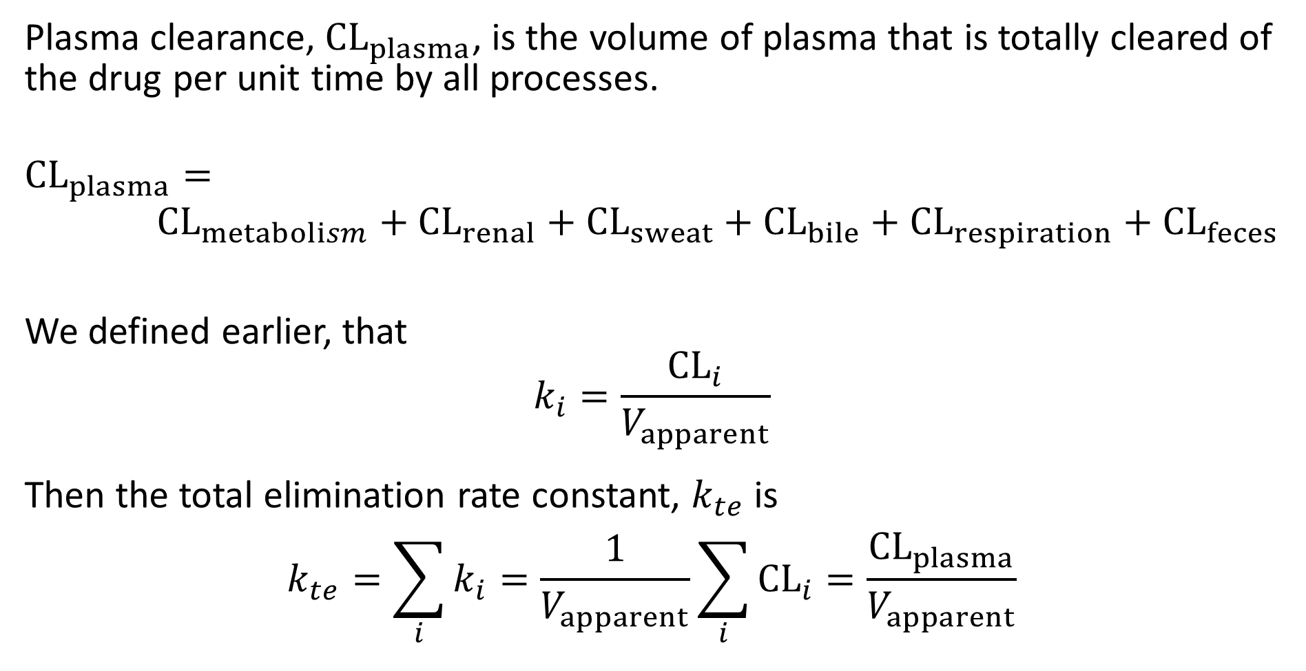
Plasma Clearance
Plasma clearance, ${\text{CL}}_{plasma}$, is the volume of plasma that is totally cleared of the drug per unit time by all processes.
$${\text{CL}}_{plasma}=$$
$${\text{CL}}_{metabolism}+{\text{CL}}_{renal}+{\text{CL}}_{sweat}+{\text{CL}}_{bile}+{\text{CL}}_{respiration}+{\text{CL}}_{feces}$$
We defined earlier, that
$$k_{i}=\frac{{\text{CL}}_{i}}{V_{apparent}}$$
Then the total elimination rate constant, $k_{te}$ is
$$k_{te}=\sum_{i}{k_{i}}=\frac{1}{V_{apparent}}\sum_{i}{{\text{CL}}_{i}}=\frac{{\text{CL}}_{plasma}}{V_{apparent}}$$

Slide 24
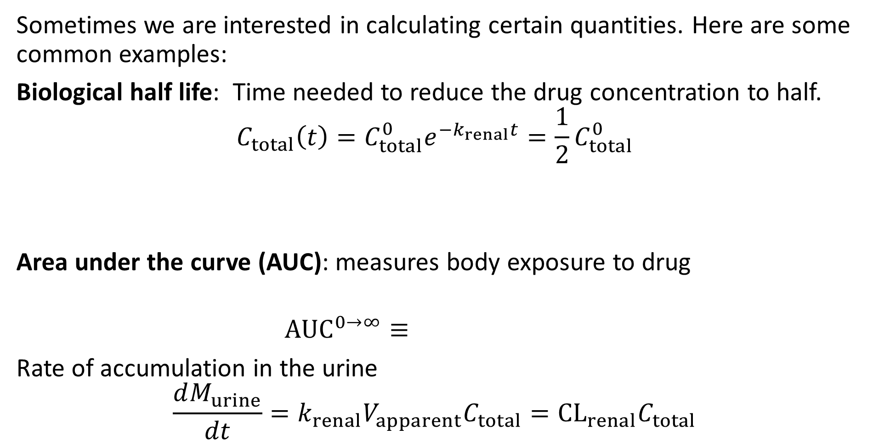
Additional Quantities
Sometimes we are interested in calculating certain quantities. Here are some common examples:
Biological half life: Time needed to reduce the drug concentration to half.
$$C_{total}\left(t\right)=C_{total}^{0}e^{−k_{renal}t}={\frac{1}{2}C}_{total}^{0}$$
Area under the curve (AUC): measures body exposure to drug
$${\text{AUC}}^{0→∞}≡$$
Rate of accumulation in the urine
$$\frac{dM_{urine}}{dt}=k_{renal}V_{apparent}C_{total}={\text{CL}}_{renal}C_{total}$$

